Slide 1
Virtual AskQC Office Hours
Cataloging Rare Materials Defensively
OCLC Metadata Quality
June 2023

Slide 2
Housekeeping
This session is being recorded

Slide 3
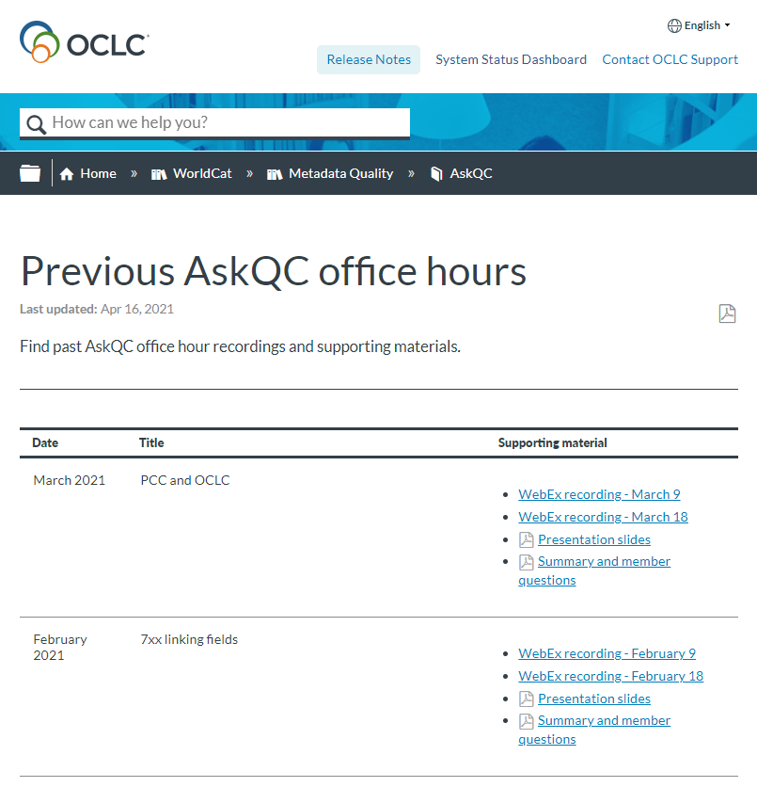
Housekeeping
This session is being recorded
All session recordings, slides, and notes are available at oc.lc/askqc

Slide 4
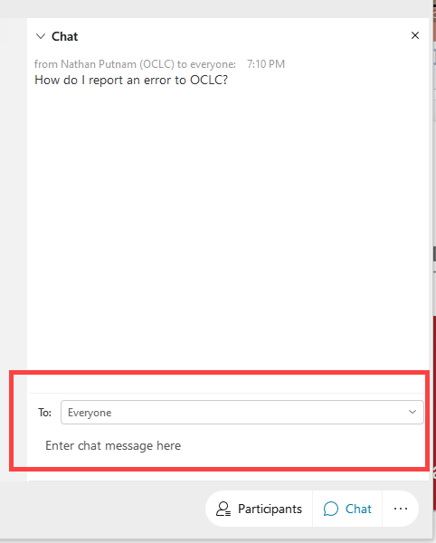
Housekeeping
This session is being recorded
All session recordings, slides, and notes are available at oc.lc/askqc
Enter questions in chat to “Everyone” at any time during the presentation

Slide 5
Housekeeping
This session is being recorded
All session recordings, slides, and notes are available at oc.lc/askqc
Enter questions in chat to “Everyone” at any time during the presentation.
After the session, you will be directed to a brief, optional survey

Slide 6
On the Call Today
Cynthia Whitacre
Jay Weitz
Kate James
Senior Metadata Operations Manager
Senior Consulting Database Specialist
Program Coordinator Metadata Engagement
Megan Johnson
Laura Ramsey
Associate Data Analyst
Senior Metadata Operations Manager

Slide 7
Cataloging Rare Materials Defensively
Jay Weitz Senior Consulting Database Specialist
Kate James
Program Coordinator
Metadata Engagement

Slide 8
Today We Will Cover:
Introduction
“Cataloging Defensively” Information
DDR
Scope of Rare Materials
Transcription
Differentiating Editions and Impressions
Notes
Elements for Rare Materials
Conclusion
Notes:
Today We Will Cover
Thank you, Cynthia.
We'll begin with a brief review of the whole idea of "cataloging defensively," a history of the development of Duplicate Detection and Resolution, and a bit about what we mean when we talk about "rare materials." Then Kate will go into some detail about options for transcriptions, differentiating various kinds of editions and impressions, the importance of note fields, and such elements as a book's format, signatures, and field 510 references to published descriptions.

Slide 9
Introduction

Slide 10
OCLC’s “Cataloging Defensively” Page
Previous presentations are located here:
https://help.oclc.org/WorldCat/Cataloging_documentation/Reference/Cataloging_defensively
General Overview
Maps
Scores
Sound Recordings
Videorecordings
Edition Statements
Photo by Markus Spiske on Unsplash
Notes:
OCLC’s “Cataloging Defensively” Page
When I first conceived the idea of “Cataloging Defensively” around 2010, we were wrapping up the five-year development and testing of the new Duplicate Detection and Resolution (DDR) software (about which, more in a few moments). We knew how much more powerful and exacting the new DDR would be, leading me to think about how much more important than ever it was to make sure that bibliographic records were as complete and accurate as possible so that the new DDR would behave correctly. After those years of concentrating on the careful cleaning up of duplicates, I flipped my perspective to try to help catalogers defend legitimately distinct records that might be mistaken for duplicates if they were not well-cataloged.
The entire OCLC “Cataloging Defensively” series is available on the “Cataloging Defensively” page of the OCLC website (https://help.oclc.org/WorldCat/Cataloging_documentation/Reference/Cataloging_defensively). The first presentation from 2010 was a general overview of “Cataloging Defensively.” We began producing these Virtual AskQC Office Hours in 2018 and have since created more than fifty all together. The second VAOH session from February 2018 was devoted to "Cataloging Defensively with Edition Statements“ (https://help.oclc.org/WorldCat/Metadata_Quality/AskQC/Previous_AskQC_office_hours/100_2018_AskQC_office_hours), which is the most recent in the series, concentrated specifically on the use of edition statements. In between 2010 and 2018 were individual presentations devoted to maps, scores, sound recordings, and video recordings. Dealing with rare materials was the final one I had planned.
Please understand that the “Cataloging Defensively” presentations are not intended to serve as cataloging workshops, per se, but are designed to give some background to how OCLC’s Duplicate Detection and Resolution (DDR) software deals with bibliographic records, both generally and for specific bibliographic formats. The presentations have been intended to help catalogers use MARC 21 and the instructions in both RDA and AACR2 to the best advantage in making sure that DDR performs appropriately when encountering a record that is legitimately unique according to the descriptive conventions.

Slide 11
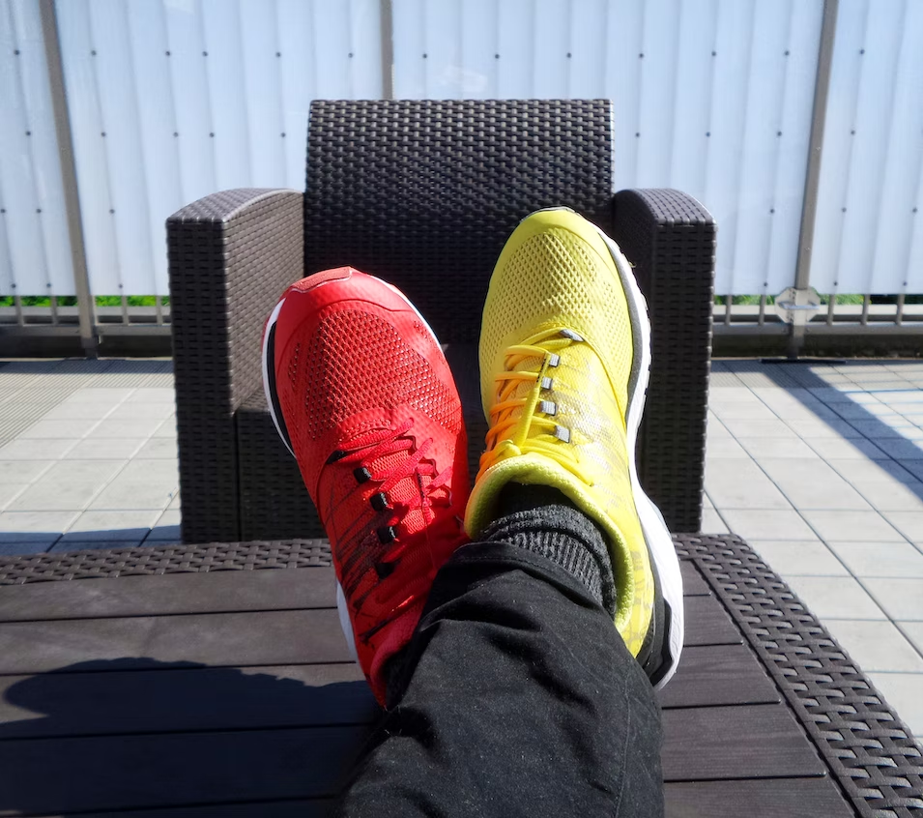
Other “Cataloging Defensively” Information
When to Input a New Record
OCLC Bibliographic Formats and Standards (BFAS), Chapter 4
https://www.oclc.org/bibformats/en/input.html
Differences Between, Changes Within: Guidelines on When to Create a New Record
ALA’s Association for Library Collections and Technical Services (ALCTS)
https://www.ala.org/alcts/sites/ala.org.alcts/files/content/resources/org/cat/differences07.pdf
Photo by Possessed Photography on Unsplash
Notes:
Other “Cataloging Defensively” Information
OCLC’s “When to Input a New Record,” Chapter 4 of Bibliographic Formats and Standards, has long served to provide a common basis for decision-making in the cooperative creation of bibliographic records in WorldCat. “When to Input …” has also been the public reflection of how OCLC's matching algorithms (including Duplicate Detection and Resolution (DDR) and automated loading of records) are intended to work.
In 2004, what was then the American Library Association’s Association for Library Collections and Technical Services (ALCTS) first published “Differences Between, Changes Within: Guidelines on When to Create a New Record,” which supplemented the descriptive cataloging rules of AACR2. The document, revised in 2007, provides guidance to the cataloger who has found a WorldCat record that may be a near match to the item in hand about whether to use that record or to create a new one. Although ALCTS has since become part of ALA’s Core Division, “Differences Between” remains available as a free PDF file on the ALA Web site.
“Differences Between, Changes Within” is a valuable supplement to OCLC’s “When to Input,” but does not replace it for those who use WorldCat. On most major points, the two documents agree. There are, however, several areas in which OCLC, because of the unique cooperative nature of WorldCat, has chosen to differ. OCLC requests that users follow OCLC practice in these instances. “When to Input” and “DBCW” cannot deal with every possible situation; likewise, this Webinar cannot consider every possible situation.

Slide 12
Duplicate Detection and Resolution (DDR)
Original DDR (1991-2005)
Dealt with Books format records only
1.6 million Books duplicates merged
New DDR (developed 2005-2010)
Deals with all bibliographic formats
Began late January 2010, completed “walk through WorldCat” late September 2010
5.1 million duplicates merged
Continues to consider new and modified WorldCat records daily
Over 70.2 million duplicates merged (August 2009 through February 2023)
Notes:
Duplicate Detection and Resolution (DDR)
OCLC’s Duplicate Detection and Resolution (DDR) software originally ran sixteen times through WorldCat between 1991 and 2005, eliminating a total of nearly 1.6 million duplicate records in the Books format.
In 2005, we began a project to thoroughly revamp DDR for the Connexion platform, taking advantage of all of its new capabilities as well as other advances in technology.
After four years of development and testing, in May 2009 we began to process small test subsets of WorldCat, an eventual total of roughly 500,000 records. During that phase we individually examined every single one of some 15,000 merges, fine-tuning our algorithms and retesting each time we found a merge that was incorrect.
In late January 2010, we began two parallel DDR processes, the first looking at each day’s new and updated records, the second “walking” the WorldCat database beginning with OCLC Record #1. That first process continues daily and has merged over 18 million duplicates. That second process completed on September 30, 2010 , going through over 166 million records and merging 5.1 million duplicates. We have continued to monitor the results and encourage all users to report incorrect merges to us. We pull apart incorrect merges when possible and keep adjusting our algorithms to be as accurate as they can be. Since 2009, DDR has eliminated more than 70.2 million duplicate records.
Since the full implementation of the new DDR, it has been more important than ever to create a bibliographic record that clearly distinguishes itself from similar records in cases where separate records are justified. This presentation “Cataloging Rare Materials Defensively” attempts to instruct OCLC users about safeguarding justifiably unique bibliographic records for rare and archival materials that should not be merged.

Slide 13
Records Exempt from DDR: General
All records with publication/production up to and including 1829
All records for original rare/archival materials coded with any of 32 MARC Descriptive Convention Source Codes in field 040 subfield $e
In consultation with Rare Books and Manuscripts Section, Bibliographic Standards Committee of ACRL and with the rare and archival materials communities
amim, amremm, appm, bdrb, cco, cgcrb, dacs, dcarlisnaaf, dcgpm, dcrb, dcrmb, dcrmc, dcrmg, dcrmm, dcrmmss, dcrmr, dcrms, dmbsb, enol, estc, fiafcm, gihc, hmstcn, iosr, kam, nmxcmdf, ohcm, rad, rna, rnab, vd16, vd17
Notes:
Records Exempt from DDR: General
From the very beginning of automated DDR back in 1991, records for resources with dates of publication/production earlier than 1801 had been set aside and not processed.
In 2011, in consultation with the Rare Books and Manuscripts Section (RBMS) of the Bibliographic Standards Committee of ACRL, we exempted from DDR all records for original materials that were coded with any of four descriptive conventions in field 040 subfield $e: bdrb, dcrb, dcrmb, dcrms. In March 2016, we expanded that list of exempted rare and archival materials descriptive conventions to include twenty additional MARC Descriptive Convention Source Codes (http://www.loc.gov/standards/sourcelist/descriptive-conventions.html) in field 040 subfield $e, following further consultations with the larger rare and archival materials communities. Another code announced by LC in September 2016 was added to that list, bringing the total to 25 codes. In 2020, as the result of additional discussions with RBMS, a more historically informed demarcation date, up to and including 1829, was implemented. In 2022, seven additional descriptive convention codes -- including “dcrmr” for the “RDA Edition” of “Descriptive Cataloging of Rare Materials” and the others highlighted in yellow -- were exempted from automated DDR processing, for a total of 32 codes.
amim: Archival moving image materials (Washington: Library of Congress)
amremm: Pass, Gregory A. Descriptive cataloging of ancient, medieval, Renaissance, and early-modern manuscripts (Chicago: Association of College & Research Libraries)
appm: Hensen, Steven L. Archives, personal papers, and manuscripts (Washington: Library of Congress)
bdrb: Bibliographic description of rare books (Washington: Library of Congress, Cataloging Distribution Service)
cco: Cataloging cultural objects: a guide to describing cultural works and their images (Chicago: Visual Resources Association, American Library Association)
cgcrb: Cataloging guidelines for creating Chinese rare book records in machine-readable form = 中文善本書機讀目錄編目規則 (Research Library Group)
dacs: Describing archives: a content standard (Chicago: Society of American Archivists)
dcarlisnaaf -- Best Practices for Cataloging Artist Files Using MARC (ARLIS)
dcgpm: Descriptive cataloging guidelines for pre-Meiji Japanese books (Subcommittee on Japanese Rare Books, Committee on Japanese Materials, Council on East Asian Libraries)
dcrb: Descriptive cataloging of rare books (Washington, DC: Cataloging Distribution Service, Library of Congress)
dcrmb: Descriptive cataloging of rare materials (Books) (Washington, DC: Cataloging Distribution Service, Library of Congress)
dcrmc: Descriptive cataloging of rare materials (Cartographic) (Chicago: Rare Books and Manuscripts Section of the Association of College and Research Libraries)
dcrmg: DCRM(G): Descriptive cataloging of rare materials (Graphics) (Rare Books and Manuscripts Section, Association of College & Research Libraries)
dcrmm: DCRM(M): Descriptive cataloging of rare materials (Music) (Rare Books and Manuscripts Section of the Association of College and Research Libraries)
dcrmmss: DCRM(MSS): Descriptive cataloging of rare materials (Manuscripts) (Chicago: Rare Books and Manuscripts Section of the Association of College and Research Libraries)
dcrmr -- Descriptive Cataloging of Rare Materials (RDA Edition) Chicago: Rare Books and Manuscripts Section of the Association of College and Research Libraries)
dcrms: Descriptive cataloging of rare materials (Serials) (Washington, DC: Cataloging Distribution Service, Library of Congress)
dmbsb: Dokumentation av materialets behandling i SB 1700-1829 (Stockholm: Kungl. Biblioteket)
enol: Ekspertiza i nauchno-tekhnicheskaia obrabotka lichnykh arkhivnykh fondov: metodicheskiie rekomendatsii (Moskva: Gosudarstvennaia biblioteka SSSR im. V. I. Lenin)
estc: Eighteenth century short title catalogue, the cataloguing rules (London: The British Library)
fiafcm -- FIAF moving image cataloguing manual (International Federation of Film Archives)
gihc: Betz, Elisabeth W. Graphic materials (Washington: Library of Congress)
hmstcn -- Handleiding voor de medewerkers aan de STCN ('s Gravenhage: Koninklijke Bibliotheek) [Short title catalog of the Netherlands]
iosr: “Instruktsiia po opisaniiu slaviano-russkikh rukopisei XI-XIV vv. dlia Svodnogo kataloga rukopisei, khraniashchikhsia v SSSR” in Arkheologicheskii ezhegodnik za 1975 god. (Moskva: Izd-vo Akademii)
kam -- Pravilnik za opis i pristup gradji u knjiznicama, arhivima i muzejima (Zagreb: Hrvatski drzavni arhiv : Muzejski dokumentacijski centar : Nacionalna i sveucilisna knjiznica u Zagrebu)
nmxcmdf -- Norma Mexicana NMX-R-069-SCFI-2016: Documentos Fotográficos-Lineamientos para su Catalogación (México. Secretaría de Economía. Dirección General de Normas)
ohcm: Matters, Marion E. Oral history cataloging manual (Chicago: Society of American Archivists)
rad: Rules for archival description (Ottawa: Bureau of Canadian Archivists)
rna: Regeln zur Erschließung von Nachlässen und Autographen (RNA)
rnab -- Ressourcenerschließung mit Normdaten in Archiven und Bibliotheken (RNAB) für Personen-, Familien-, Körperschaftsarchive und Sammlungen
vd16: Formalerschliessung nach dem Verzeichnis der Drucke des 16. Jahrhunderts (VD 16)
vd17: Formalerschliessung nach dem Verzeichnis der Drucke des 17. Jahrhunderts (VD 17)

Slide 14
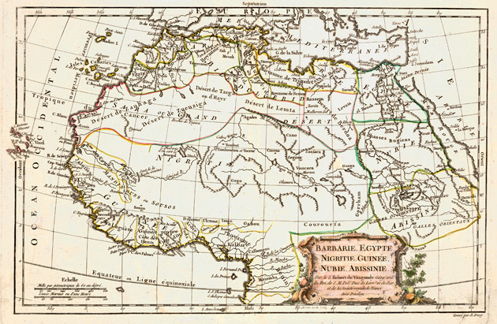
Records Exempt from DDR: Formats
All records for cartographic materials with publication/production dates earlier than 1901
In consultation with MAGIRT CCC
All records for photographs (Material Types pht and pic)
Usually supplied, generic, undifferentiable titles
Image courtesy of the Map and Imagery Library, George A. Smathers Libraries, University of Florida (https://ufdc.ufl.edu/UF00001643/00001/images)
Notes:
Records Exempt from DDR: Formats
In consultation with the American Library Association (ALA) Map and Geospatial Information Round Table (MAGIRT) Cataloging and Classification Committee (CCC), we have further exempted records for cartographic materials (Types “e” and “f”) with dates of publication earlier than 1901.
In addition, we exempt from DDR processing all records for resources that can be identified as photographs (Material Types “pht” for photograph and/or “pic” for picture). They are commonly unique, unpublished, and have cataloger-supplied, generic, undifferentiable titles and are otherwise described in ways that don’t lend themselves to being distinguished from each other, especially through automated means.
We also exempt from DDR all Digital Collection Gateway records (identified by particular codes in field 029 subfield $t) and all SCIPIO records (identified by code “scipio” in field 042).

Slide 15
Cataloging Defensively Basics
Cataloging Defensively = Cataloging Carefully
Be sure to search thoroughly
When deriving a new record from an existing one, be sure to make all of the changes to the record that convinced you a separate record was justified in the first place
When editing an existing record, be sure that you never change the essential identity of an existing bibliographic record to something else
Be sure that the coding and tagging are correct and complete
Be sure to proofread the record
Notes:
Cataloging Defensively Basics
By far, the best advice you will ever hear about “Cataloging Defensively” is to catalog carefully. That includes:
Be sure to search thoroughly
When deriving a new record from an existing one, be sure that to make all of the changes to the record that convinced you a separate record was justified in the first place
When editing an existing record, be sure that you never change the essential identity of an existing bibliographic record to something else
Be sure that the coding and tagging of your resulting record are correct and complete
Miscoded fields and subfields, and missing subfields can cause data to be ignored or misinterpreted by an automated process
Be sure to proofread the record
Use the spell-check provided in Connexion, but remember that not all typos will be caught by a spell-check

Slide 16
Cataloging Defensively Basics, cont.
Cataloging Defensively = Cataloging Carefully
Be sure that the record is internally consistent, with coded data corresponding correctly to descriptive data, including:
Ctry and 260/264 subfield $a
Date 1 and 260/264 subfield $c
Form coding for electronic resources, microforms, Braille, large print, when appropriate
006s to account for additional aspects of a resource, when appropriate
007s correctly reflecting physical characteristics, when appropriate
856 Second Indicator correctly coded, when appropriate
Notes:
Cataloging Defensively Basis, cont.
Cataloging Defensively = Cataloging Carefully
Be sure that the record is internally consistent, with coded data corresponding correctly to descriptive data, when appropriate, including:
Country of Publication (Ctry) will usually represent the first named place in 260/264 subfield $a
Date 1, Date 2, and Type of Date/Publication Status (DtSt) must correctly reflect the date or dates found in 260/264 subfield $c and, if appropriate, other date-related areas of the bibliographic record
Form of Item (Form) must be correctly coded for tangible and remote electronic resources, microforms, Braille, large print, and regular print reproductions when appropriate
In cases where field 006 is appropriate for an additional aspect of the resource, make sure the Form in field 006 correctly agrees with the Form coding in field 008
If field 006 represents accompanying material, code Form for that accompanying material, as appropriate
Use appropriate fields 006 to account for additional aspects of a resource, when that is called for
Code appropriate fields 007 to account for physical characteristics, when that is called for
A correctly coded field 856 Second Indicator, when field 856 is appropriate, is crucial for differentiating remotely-accessed from tangible resources
These elements are all taken into consideration by DDR’s algorithms, and any inaccuracies or inconsistencies might result in DDR not acting correctly.

Slide 17
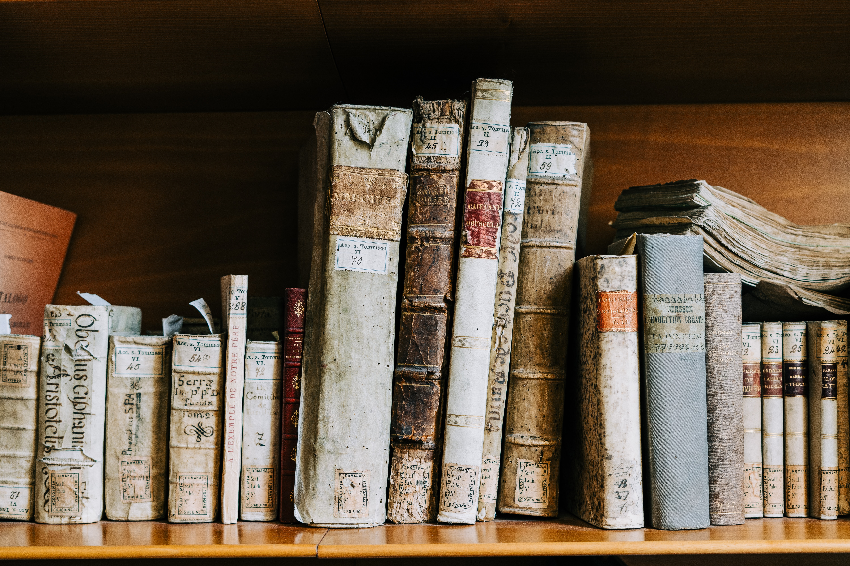
Scope of “Rare Materials”
DCRMR i.01.11:
“The term ‘rare materials’ is used to refer to any special materials that repositories have chosen to distinguish from general materials by the ways in which they house, preserve, or collect them. Rarity in the narrow sense of ‘scarcity’ may or may not be a feature of these materials.”
Photo by Gabriella Clare Marino on Unsplash
Notes:
Scope of “Rare Materials”
For rare and archival materials, remember to include in field 040 subfield $e the code of the descriptive convention (or conventions) that you have cataloged under. Including one of the 32 rare or archival codes will ensure that DDR ignores that record. This includes any resource that may not be literally “rare” but that your institution has chosen to catalog under one of those descriptive conventions in order to distinguish it from similar resources. Although that tradition goes back for generations, the introduction of Descriptive Cataloging of Rare Materials (RDA Edition) (DCRMR i.01.11) states it quite nicely: “The term ‘rare materials’ is used to refer to any special materials that repositories have chosen to distinguish from general materials by the ways in which they house, preserve, or collect them. Rarity in the narrow sense of ‘scarcity’ may or may not be a feature of these materials.” This can include such things as limited editions, annotated copies of larger printings, special collections in your institution that highlight aspects of a publication that may not be brought out under what we might call “ordinary” cataloging. Of course, there is no requirement that one of the descriptive conventions for rare materials must be used to catalog these resources. If you choose not to catalog such materials under one of the rare descriptive conventions, it is even more important that the general advice of the “Cataloging Defensively” series is taken into consideration.

Slide 18
Information about DCRM Manuals
DCRM RDA Edition (DCRMR) is aligned with the RDA element set and is approved for cataloging, but is “currently a minimum viable product containing book instructions only”
Previous DCRM manuals are format-specific and align (mostly) with AACR2
DCRM(B) is for books
DCRM(C) is for cartographic resources
DCRM(G) is for graphic materials
DCRM(M) is for music
DCRM(MSS) is for early modern manuscripts
DCRM(S) is for serials
Previous to the DCRMs, there was Descriptive Cataloging of Rare Books (DCRB)
Notes:
Information about DCRM Manuals
Here is some information about the various DCRM manuals. The latest DCRM is “DCRM RDA Edition.” The manual was approved by the RBMS Executive Committee and officially published on February 2, 2022. Note that is described as a “minimum viable product containing book instructions only.” The format-specific DCRMs were written to align with AACR2 but are also used with RDA.

Slide 19
Other Manuals for Rare Materials
Descriptive Cataloging of Ancient, Medieval, Renaissance, and Early Modern Manuscripts (AMREMM) for early manuscripts
Describing Archives: A Content Standard (DACS) for archival materials, individual and collections
Replaced Archives, Personal Papers, and Manuscripts (APPM) in 2005
Descriptive Cataloging Guidelines for Pre-Meiji Japanese Books (DCGPM) for Japanese printed books, manuscripts, scrolls, single-sheet publications (excluding maps and music), and Chinese books produced in Japan before the machine printing era
Archival Moving Image Materials: A Cataloging Manual (AMIM), available via Cataloger’s Desktop
Notes:
Other Manuals for Rare Materials
These are other manuals often used for certain types of rare materials.

Slide 20
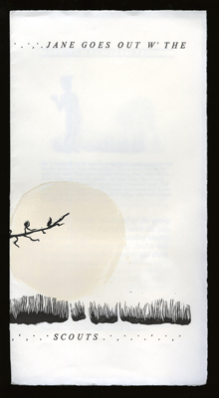
Artist Book Cataloged with DCRM(B)
040 |  |  | DLC ǂb eng ǂe dcrmb ǂc DLC
100 | 1 |  | Drucker, Johanna, ǂd 1952-
245 | 1 | 0 | Jane goes out w' the scouts.
260 |  |  | [Oakland, CA : ǂb Drucker, ǂc 1980]
300 |  |  | [8] pages : ǂb illustrations (linoleum prints) ; ǂc 32 cm
500 |  |  | Letterpress printed in handset Century italic on Rives lightweight, four pages; printed in the garage of Rebis Press in Oakland; see Drucker, Chronology of books....
510 | 4 |  | Drucker, J. Chronology of books from 1970 to 1994 (www.epc.buffalo.edu/authors/drucker/chron), ǂc 1980/2
710 | 2 |  | Rebus Press.
710 | 2 |  | Press Collection (Library of Congress) ǂ5 DLC
Image from Johanna Drucker’s website
http://www.johannadrucker.net/books.html
Notes:
This is an example of a modern publication cataloged with DCRMB. Johanna Drucker is a well-known book artist. The cataloger may have chosen to use DCRMB because of the detailed information about illustrations, citation in field 510 of the Chronology of books from 1970 to 1994 and the access points for Rebus Press and the Press Collection, which is copy-specific.
If your library owned a copy of this book and you wanted to catalog it using RDA, you would not input a new record. You could upgrade the record to RDA, adding “$e rda” to the 040 field after the subfield $e dcrmb. If you were to have a copy of the record in your local catalog, you might wish to delete the copy specific 710 in your local catalog record. It should not be removed from the WorldCat record.

Slide 21
Online (Manuscript)
Online (Printed)
040 |  |  | … ǂb eng ǂe rda ǂe pn ǂe dcrmm …
100 | 1 |  | Dalayrac, N. ǂq (Nicolas), ǂd 1753-1809, ǂe composer.
245 | 1 | 4 | Deux mots ou Une nuit dans la foret.
260 |  | 0 | [Italy] : ǂb [producer not identified], ǂc [1806?]
300 |  |  | 1 online resource (1 score (110 pages))
500 |  |  | Production information supplied by cataloger.
588 |  |  | Description based on online resource.
040 |  |  | … ǂb eng ǂe rda ǂe pn ǂe dcrmm …
100 | 1 |  | Dalayrac, N. ǂq (Nicolas), ǂd 1753-1809, ǂe composer.
245 | 1 | 0 | Deux mots ou Une nuit dans la forêt : ǂb comédie en un acte et en prose / ǂc paroles de Mr. Marsollier ; mise en musique par M. Dalayrac.
264 |  | 1 | Paris : ǂb Madame Masson ǂc [1806?]
300 |  |  | 1 online resource (1 score (110 pages))
588 | 0 |  | Online resource.
Notes:
Online/Manuscript and Online (Printed)
In this case, we have records for two online resources, both cataloged using DCRM for Music, RDA, and the provider-neutral guidelines. On the left is the online version of the manuscript musical score. On the right is the online version of the printed musical score.
956677925 dcrmm manuscript score, online 110 pages
1028740766 dcrmm published score, online 110 pages

Slide 22
Transcription

Slide 23
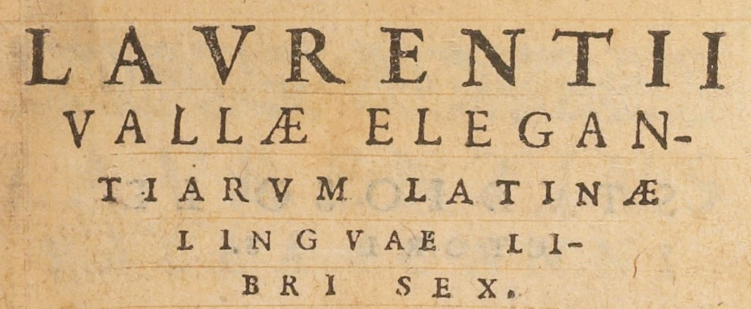
3 Valid Transcriptions
Image from Examples to Accompany Descriptive Cataloging of Rare Materials (Books), Example 12: Valla https://www.loc.gov/cds/desktop/documents/DCRMBex/Images/DCRMBex_12_ex12.jpg
Laurentij Vallae elegantiarum Latinae linguae libri sex
Laurentii Vallæ elegan-tiarvm Latinæ linguae li-bri sex
LAVRENTII VALLÆ ELEGAN-TIARVM LATINÆ LINGVAE LI-BRI SEX.
Notes:
Transcription is not an issue specific to rare materials, but it is very important when considering whether a new record should be created for a rare resource.
Differences in capitalization, punctuation, and letterforms may indicate a different manifestation or just a difference in choice of cataloging instructions. Even knowing which cataloging standards were applied does not clarify the issue because the same instruction in the same standard often has an alternative saying to do the opposite. I have provided two examples from DCRMR and RDA on the next slide.
All of these are valid transcriptions of the same title from a 1561 book by Lorenzo Valla (1407-1457) depending on which cataloging instructions are applied.
The DCRM manuals have instructions about transcribing ligatures (æ) and i/j and u/v. RDA has no special instructions about early letterforms, but LC-PCC PS for 1.4, Pre-Modern Forms of Letters covers i/j and u/v. The differences with the letters i/j and u/v are in part related to the evolution of the Latin language and in part related to printing conventions of the time period. The dashes were a printing convention used to split words and could be transcribed or omitted depending on cataloging instructions.
For example record in DCRM publication see https://www.loc.gov/cds/desktop/documents/DCRMBex/DCRMBex_12_ex12.pdf

Slide 24
Different Options Available
DCRMR 0.4.05.1: “… Generally normalize punctuation and capitalization based on current conventions, with an optional exception in punctuation (see 0.4.31.4). Optionally, retain original capitalization and punctuation following RDA Toolkit: RDA Guidelines on basic transcription and consistently apply it throughout the resource description.”
RDA 1.7.3 Punctuation: “Transcribe punctuation as it appears on the source.” or Alternative: “If transcribing punctuation as it appears on the source significantly hinders clarity, either omit or modify the punctuation, as necessary.”

Slide 25
246 Fields for Variant Titles
245 | 1 | 0 | Laurentij Vallae elegantiarum Latinae linguae libri sex ; ǂb eiusdem, De reciprocatione sui & suus libellus.
246 | 3 |  | Laurentii Vallæ elegan-tiarvm Latinæ linguae li-bri sex
246 | 3 |  | Laurentii Vallae elegantiarum Latinae linguae libri sex
246 | 3 | 0 | Elegantiarum Latinae linguae libri sex
Notes:
Providing 246 fields for these variations in transcription is helpful to the user.

Slide 26
Differentiating Editions and impressions

Slide 27
Supplied Edition Statement
“If a manifestation lacks an edition statement but is known to contain significant changes from other editions, supply an edition statement, if considered important for identification or access.”​ (RDA 2.5.1.4, Optional Addition)
“If transcribed information in the body of the description is not sufficient to distinguish the states, supply a statement of state in square brackets in the language and script of the cataloging agency.” (DCRM(G) 2B2.1.)
Newer DCRMs specify to provide such information in a note rather than supplying an edition statement

Slide 28
Print, Published state
Print, Trial proof
100 | 1 | 0 | Thew, Robert, ǂd 1758-1802.
245 | 1 | 0 | Second part of King Henry the Fourth. Act IV. Scene IV : ǂb The palace at Westminster. King Henry & the Prince of Wales / ǂc painted by Josiah Boydell ; engraved by R. Thew, Histl. Engraver to H.R.H. the Prince of Wales.
300 |  |  | 1 print : ǂb stipple engraving ; ǂc plate mark 57.5 x 42 cm, on sheet 66.8 x 52 cm
336 |  |  | still image ǂb sti ǂ2 rdacontent
100 | 1 |  | Thew, Robert, ǂd 1758-1802
245 | 1 | 0 | [Second part of King Henry the Fourth. Act IV. Scene IV].
250 |  |  | [Trial proof].
300 |  |  | 1 print : ǂb stipple ; ǂc plate mark 56.6 x 42 cm, on sheet 65.5 x 52 cm
336 |  |  | still image ǂb sti ǂ2 rdacontent
500 |  |  | Title, artist, printmaker, publisher and date from published state.
Notes:
Trial proof: impression made before work on a printing plate or block is completed to check progress of the image (basically a draft)

Slide 29
Notes about Edition Information
“If the resource does not contain an edition statement, but is known to contain significant changes from other editions, or an edition statement for it is provided by a reference source, do not supply an edition statement based on this information. Give the information in a note” (DCRM(M) 2B5.1.)
“Always record edition information, such as an Edition statement that is provided by a bibliographic or reference source for resources not containing an edition statement, but known to contain significant changes from other editions, as a Note on edition statement” (DCRMR 3.26.32.1)

Slide 30
2nd print, 3rd ed
4th version
100 | 1 |  | Schubert, Franz, ǂd 1797-1828.
245 | 1 | 4 | Die Forelle : ǂb op. 32 / ǂc Gedicht von Schubart ; in Musik gesetzt für eine Singstimme mit Begleitung des Pianoforte von Franz Schubert.
260 |  |  | Wien : ǂb Diabelli, ǂc [approximately 1827]
300 |  |  | 1 score (7 pages) ; ǂc 26 x 34 cm
500 |  |  | Second print, 3rd edition (see Deutsch 550).
100 | 1 |  | Schubert, Franz, ǂd 1797-1828.
245 | 1 | 4 | Die Forelle / ǂc Gedicht von Schubart ; in Musik gesetzt für eine Singstimme mit Begleitung des Pianoforte von Franz Schubert..
260 |  |  | Wien : ǂb Bey Ant. Diabelli, ǂc [1827]
300 |  |  | 1 score (7 pages) ; ǂc 25 x 33 cm
500 |  |  | Fourth version, 1st separate ed., later issue. Cf. Deutsch, 550.
Notes:
These are examples of different manifestations of the same Shubert score “Die Forelle” using the element Note on Edition Statement. “Deutsch 550” refers to a number entry in a thematic catalog of Schubert’s compositions.

Slide 31
Notes

Slide 32
The Importance of Notes
Notes recorded in 5XX fields may provide important information identifying similar manifestations
Notes may indicate different printings (different type-settings) that justify a new record for rare materials
Copy-specific notes (590 or 5XX with ǂ5) do not indicate different manifestations

Slide 33
A bill (26 lines)
A bill (25 lines)
245 | 1 | 0 | A bill to establish an uniform system of bankruptcy throughout the United States.
260 |  |  | [Philadelphia] : ǂb Printed by Childs and Swaine, ǂc [1794?]
300 |  |  | 13, [1] p. ; ǂc 33 cm. (fol.)
500 |  |  | Last line on p. [1] is numbered 26 and reads "for and recover the same in his own name and to his own use.“
500 |  |  | Signatures: [A]² B-C² [D]1.
510 | 4 |  | Bristol ǂc B8949
245 | 1 | 0 | A bill to establish an uniform system of bankruptcy throughout the United States.
260 |  |  | [Philadelphia? : ǂb s.n., ǂc 1794?]
300 |  |  | 13, [1] p. ; ǂc 34 cm. (fol.)
500 |  |  | Last line on p. [1] is numbered 25 and reads "the same in his own name and to his own use."
500 |  |  | Not in Evans or Bristol.
500 |  |  | Signatures: [A]² B-C² D1.

Slide 34
ElEments for Rare Materials
Note: These elements are often found in bibliographic records for rare materials, but they are not exclusive to rare materials.

Slide 35
Bibliographic Format
RDA definition: “A proportional relationship between a whole sheet in a printed or manuscript resource, and the individual leaves that result if that sheet is left full, cut, or folded.”
RDA 3.12 and DCRMR 6.29
Bibliographic format identifies a manifestation by providing information about its leaves, e.g., chain-lines direction, uncut height, and watermark position
May be recorded in field 300 and/or 340
Example: 300 39 pages : ǂb illustrations (woodcuts) ; ǂc 20 cm (8vo)
Example: 340 ǂm 8vo ǂ2 rdabf
Notes:
This element can be recorded in field 300, field 340, or both. Subfield $m (Book format) was added to field 340 (Physical medium) in 2011.

Slide 36
Hamlet 12mo
Hamlet 8vo
245 | 1 | 0 | Hamlet, Prince of Denmark : ǂb a tragedy : as it is now acted by His Majesty's Servants / ǂc written by William Shakespear.
260 |  |  | London : ǂb Printed by J. Darby for M. Wellington at the King's Head, over against St. Clement's Church, in the Strand, ǂc 1718.
300 |  |  | 107, [1] p. : ǂb 1 ill. (engraving) ; ǂc 17 cm (12mo)
340 |  |  | ǂm 12mo ǂ2 rdabf
500 |  |  | Signatures: A-I⁶.
510 | 4 |  | ESTC ǂc T35952
245 | 1 | 0 | Hamlet, Prince of Denmark : : ǂb a tragedy / ǂc written by Mr. William Shakespear.
260 |  |  | London [i.e. The Hague] : ǂb [s.n.], ǂc printed in the year 1710.
300 |  |  | 127, [1] p. ; ǂc 17 cm. (8vo)
340 |  |  | ǂm 8vo ǂ2 rdabf
500 |  |  | Signatures: A-H⁸.
510 | 4 |  | ESTC ǂc N17297

Slide 37
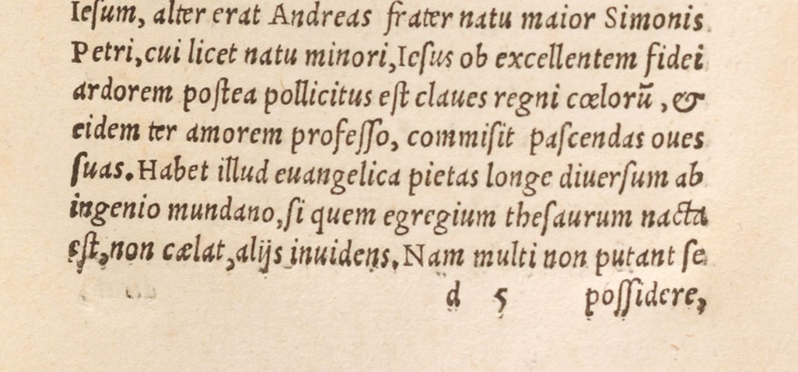
Signatures
Image from Examples to Accompany Descriptive Cataloging of Rare Materials (Books), Example 7: Erasmus https://www.loc.gov/cds/desktop/documents/DCRMBex/Images/DCRMBex_07C_ex07.jpg
Signature: “A letter, numeral, symbol, or a group of such characters, printed at the foot of the rectos of the first few leaves of an intended gathering for the purpose of aiding binders in correctly assembling the sections” (DCRMR)
Not an RDA element, but appropriate to record as Other Details of Extent (3.21.2.11)
Covered by DCRMR 6.215.44

Slide 38
Hamlet 12mo
Hamlet 8vo
245 | 1 | 0 | Hamlet, Prince of Denmark : ǂb a tragedy : as it is now acted by His Majesty's Servants / ǂc written by William Shakespear.
260 |  |  | London : ǂb Printed by J. Darby for M. Wellington at the King's Head, over against St. Clement's Church, in the Strand, ǂc 1718.
300 |  |  | 107, [1] p. : ǂb 1 ill. (engraving) ; ǂc 17 cm (12mo)
500 |  |  | Signatures: A-I⁶.
510 | 4 |  | ESTC ǂc T35952
245 | 1 | 0 | Hamlet, Prince of Denmark : ǂb a tragedy / ǂc written by Mr. William Shakespear.
260 |  |  | London [i.e. The Hague] : ǂb [s.n.], ǂc printed in the year 1710.
300 |  |  | 127, [1] p. ; ǂc 17 cm. (8vo)
500 |  |  | Signatures: A-H⁸.
510 | 4 |  | ESTC ǂc N17297

Slide 39
References to Published Descriptions
DCRMR 9.32.31
Provides information from a published description about the manifestation
Standard Citations Forms for Rare Materials Cataloging provides sources and instructions about citing them
Earlier versions of Standard Citations forms were book-focused and contained more abbreviations

Slide 40
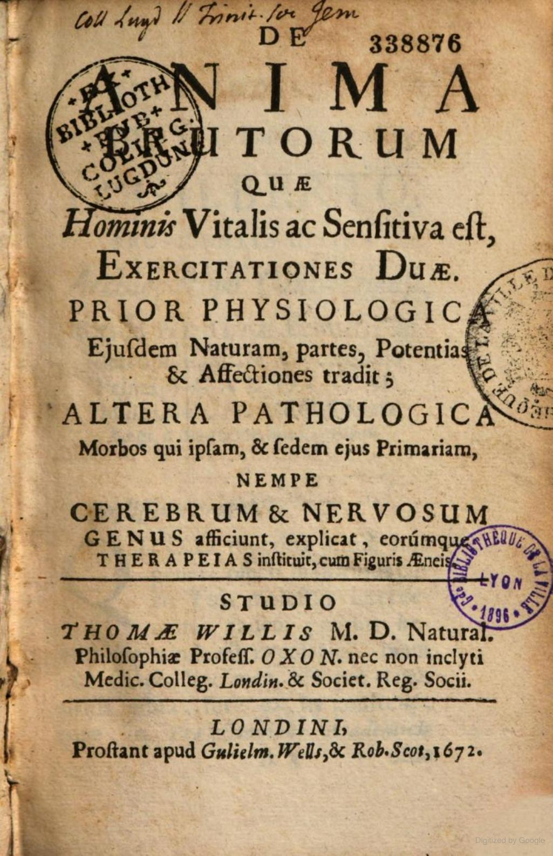
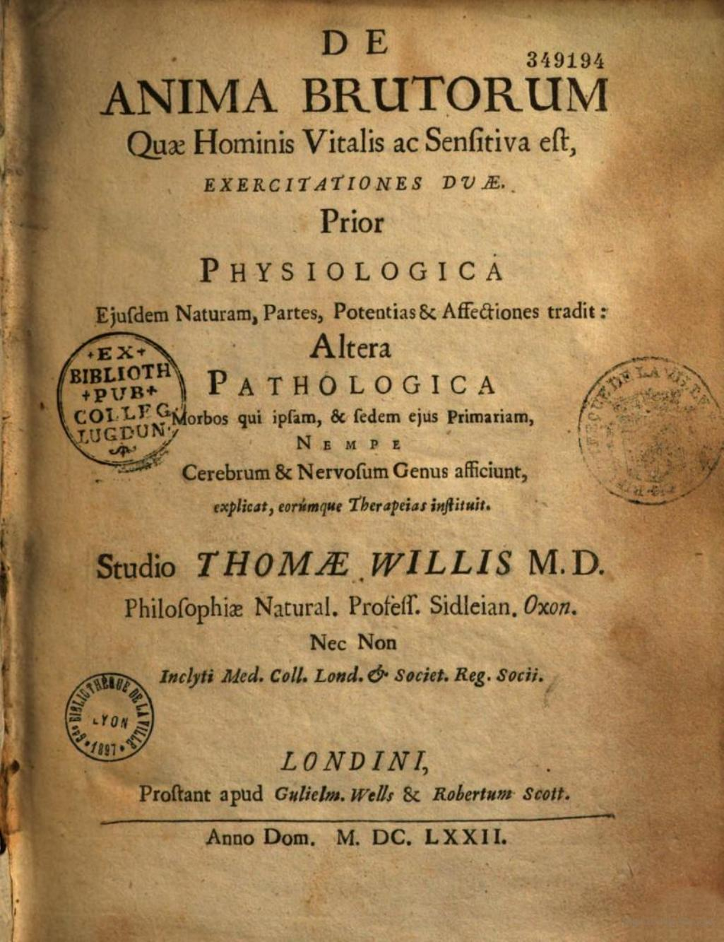
Images from Google Books

Slide 41
De anima R186612
De anima R186611
245 | 1 | 0 | De anima brutorum quae hominis vitalis ac sensitiva est, exercitationes duae
264 |  | 1 | Londini, : ǂb Prostant apud Guiel. Wells & Rob. Scot, ǂc 1672.
300 |  |  | [48], 400, [16] pages, viii leaves of plates (folded) : ǂb illustrations ; ǂc 16 cm (8vo)
500 |  |  | Cf. Wing W2828 which has “Guilelm. Wells & Robertum Scott” in the imprint.
510 | 4 |  | ESTC ǂc R186612
510 | 4 |  | Wing (CD-ROM, 1996), ǂc W2828
245 | 1 | 0 | De anima brutorum quae hominis vitalis ac sensitiva est, exercitationes duae
260 |  |  | Londini : ǂb Prostant apud Gulielm. Wells, & Robertum Scott, ǂc anno Dom. MDCLXXII [1672]
300 |  |  | [54], 565 [i.e. 547], [16] p. : ill. ; 21 cm (4to)
510 | 4 |  | ESTC ǂc R186611
500 | 4 |  | Wing (CD-ROM, 1996), ǂc W2827
Notes:
ESTC=English Short Title Catalogue
Wing refers to “Short-title catalogue of books printed in England, Scotland, Ireland, Wales, and British America, and of English books printed in other countries, 1641-1700” by Donald Wing

Slide 42
Conclusion

Slide 43
Reminders
DDR tries both to differentiate legitimately separate records and to bring duplicates together
Catalogers can assist DDR in both efforts by careful, accurate, and thorough cataloging
Catalogers may help end users and each other by recording elements that distinguish among similar manifestations
Keep in mind the cooperative environment of WorldCat and its variety
If you believe a record has been merged incorrectly, email us (see next slide)
Notes:
Cataloging Rare Materials Defensively: Conclusion
The contents of this presentation barely scratch the surface of what Duplicate Detection and Resolution tries to do. We have concentrated on a few ways in which you as a cataloger might be able to assist DDR in correctly differentiating between legitimately separate bibliographic records specifically for rare materials. We have merely touched upon many of the other “defensive cataloging” measures that can be applied more generally to many sorts of bibliographic materials. We have concentrated chiefly on how DDR tries to differentiate records and provided you with information about elements you might use to help users recognize the differences among similar manifestations, thereby helping your fellow catalogers know whether an existing record matches the manifestation they are cataloging.
We hope this presentation helps you think about how you catalog rare materials in the cooperative environment of WorldCat.
If you believe a record has been incorrectly merged with another, please email us. We can usually restore the records to their pre-merged state.

Slide 44
Questions
Thank you for your kind attention
askqc@oclc.org
When to Input a New Record
OCLC Bibliographic Formats and Standards (BFAS), Chapter 4
http://www.oclc.org/bibformats/en/input.html
Differences Between, Changes Within: Guidelines on When to Create a New Record
ALA’s Association for Library Collections and Technical Services (ALCTS)
https://www.ala.org/alcts/sites/ala.org.alcts/files/content/resources/org/cat/differences07.pdf
OCLC’s “Cataloging Defensively” Page
https://help.oclc.org/WorldCat/Cataloging_documentation/Reference/Cataloging_defensively
Photo by Matt Walsh on Unsplash
Notes:
Questions
Thank you for your kind attention.
Outside of the context of this presentation, questions about “When to Input a New Record,” DDR, and other WorldCat quality issues may always be addressed to askqc@oclc.org.
On the screen, you see that AskQC address as well as the URLs for OCLC’s “When to Input a New Record,” the ALCTS document “Differences Between, Changes Within,” and OCLC’s “Cataloging Defensively” page.
Now it’s time for your questions.

Slide 45
NAFAN research—What is it?
Building a National Finding Aid Network (NAFAN)
Make archives more easily and equitably accessible
OCLC led research supporting project
Five publications reporting on OCLC’s research findings
Promotion begins June 5
Notes:
We are publishing research findings from the Building a National Finding Aid Network project
IMLS National Leadership Grant project
Project Goal: Lay the foundation for a US finding aid network that serves as the central search point for all archival collections
Partners: California Digital Library (lead), with partners at OCLC, the University of Virginia Library, Shift Collective, and Chain Bridge Group. The project also partnered with statewide/regional finding aid aggregators and LYRASIS (ArchivesSpace) as a technical consulting partner.
https://oc.lc/nafan-research

Slide 46
Building a National Finding Aid Network (NAFAN)
OCLC led research with end users, archivists, and archival data
Goal: Make archives more accessible
Outputs: Five research reports
Research will inform future NAFAN project activities
oc.lc/nafan-research
Notes:
https://oc.lc/nafan-research

Slide 47
On the Call Today
Cynthia Whitacre
Jay Weitz
Kate James
Senior Metadata Operations Manager
Senior Consulting Database Specialist
Program Coordinator Metadata Engagement
Megan Johnson
Laura Ramsey
Associate Data Analyst
Senior Metadata Operations Manager

Slide 48
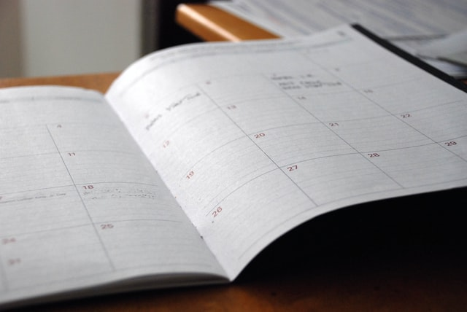
Thank You!
July 2023 Virtual AskQC Office Hours
Debiasing Dewey: Righting the past by rewriting the classification
Tuesday, 11 July at 10:00 AM Eastern
Thursday, 20 July at 4:00 PM Eastern
Registration and session links available at oc.lc/askqc
Send cataloging policy questions at any time to askqc@oclc.org
Photo by Eric Rothermel on Unsplash

