Slide 1
Virtual AskQC Office Hours
Evolution of a WorldCat record
OCLC Metadata Quality
June 2021

Slide 2
Housekeeping
This session is being recorded

Slide 3
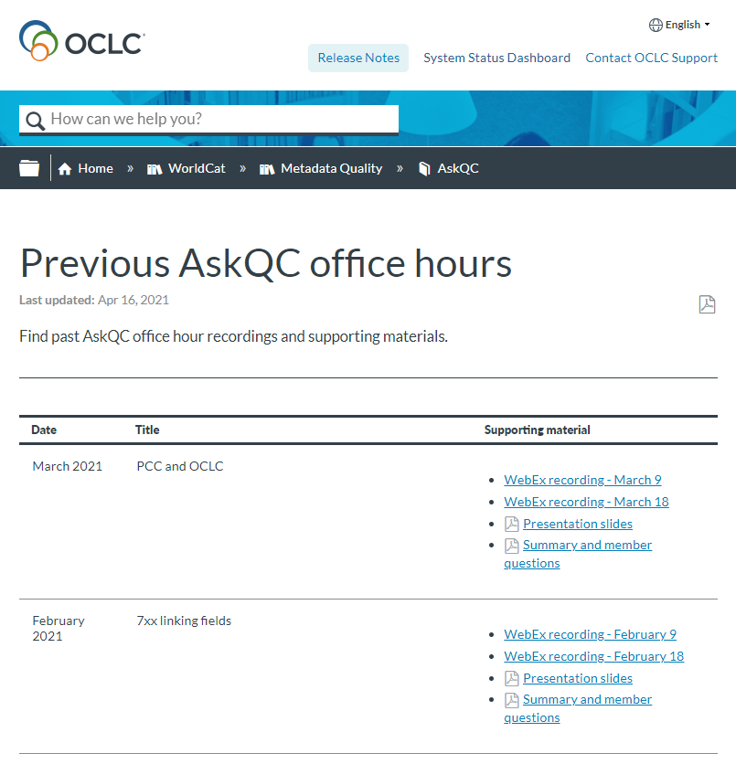
Housekeeping
This session is being recorded
All session recordings, slides, and notes are available at oc.lc/askqc

Slide 4
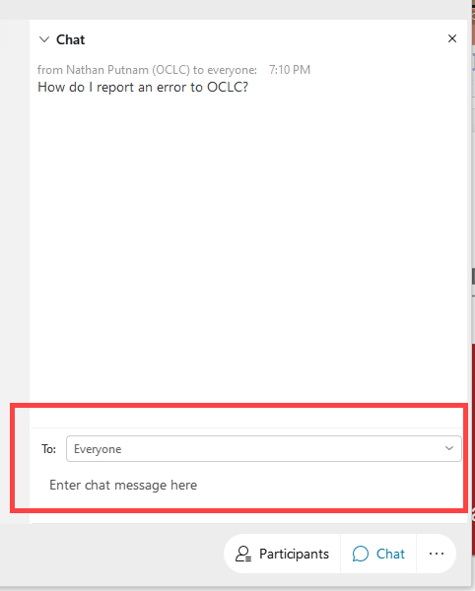
Housekeeping
This session is being recorded
All session recordings, slides, and notes are available at oc.lc/askqc
Enter questions in chat to “Everyone” at any time during the presentation

Slide 5
Housekeeping
This session is being recorded
All session recordings, slides, and notes are available at oc.lc/askqc
Enter questions in chat to “Everyone” at any time during the presentation.
After the session, you will be directed to a brief, optional survey

Slide 6
On the call today
Hayley Moreno
Laura Ramsey
Shanna Griffith
Database Specialist
Senior Metadata Operations Manager
Database Specialist
Bryan Baldus
Robert Bremer
Consulting Database Specialist
Senior Consulting Database Specialist

Slide 7
Evolution of a WorldCat record
Laura Ramsey Shanna Griffith
Senior Metadata Database Specialist
Operations Manager
Notes:
Today Shanna and I are going to talk about the evolution of a WorldCat record. You might be wondering what the title of this office hours is referring to. So, let me explain.

Slide 8
Introduction
Documentation project currently underway
Information will become available on the OCLC support site later this year
Announcement coming soon to OCLC-CAT and the Cataloging and Metadata Community Center
8
Notes:
Over the years we’ve gotten questions and requests for information both internally and externally about how many OCLC processes work, such as matching, merging, and field transfer, just to name a few. In response, we embarked on a project to develop new comprehensive documentation that will serve as a resource to provide answers to questions that we get. This documentation will outline and explain many of the processes that may act on a bibliographic record from the time it is received at OCLC through the final act of it being matched to or added to WorldCat. Therefore, it will outline the evolution of a WorldCat record. We hope to make this document publicly available later this year in a centralized location on the OCLC help site, so watch for an announcement on OCLC-CAT and in the Cataloging and Metadata Community Center.
I’ve included the links to both of those resources in the notes.
Cataloging and Metadata Community Center: https://www.oclc.org/content/community/en_us/cataloging-metadata.html
To subscribe to any OCLC distribution and discussion lists, see https://www.oclc.org/content/forms/worldwide/en/internet-subscription.html

Slide 9
Source of records
Data Sync Collections
Manual input
WorldCat Cataloging Partners
WorldCat Metadata API
9
Notes:
The first subject area that the documentation is going to cover are the various sources that we receive records from, several as seen on this slide, by which member institutions and partners may add bibliographic records and holdings to WorldCat. Each method offers a unique set of features including the ability to find an existing WorldCat record. If an existing WorldCat record is found, members may add holdings, delete holdings, or for some processes, merge data into the record. If an existing record is not found, some methods offer the ability to add a new record to WorldCat. All records that are added to WorldCat undergo various validation checks of MARC coding.
The documentation will provide details of the processes that are behind these methods.
One such question that this information might answer would be “For libraries that maintain an OCLC subscription, what methods are available for a user to manually add new records to WorldCat”?
Answer: Connexion browser, Connexion client, Record Manager, and the WorldCat Metadata API.

Slide 10
Data Prep
Bibliographic preprocessing
Validation
Sparse records
10
Notes:
The data prep section of the documentation will describe the bibliographic pre-processing that may act on a record. Incoming records must meet structural and content standards in order to be processed successfully. These measures ensure that globally known quality standards are applied to incoming bibliographic records to primarily support better matching, which also helps to ensure that records added to WorldCat are fit for purpose.
Some of the processing includes checking the integrity of the record, eliminating data from a bibliographic record that is not used in WorldCat, and validating MARC records to ensure that the structure, field tags, indicators, subfields, and content correspond to MARC 21 as implemented in WorldCat. This is a similar process to how online validation works.
And lastly, sparse records are identified and flagged as such. Sparse records lack sufficient data to identify a manifestation of an item. A sparse record may be used in matching but does not get added to WorldCat if no matching record is found.
The information detailed in this section might lead one to the answer “Why was this record flagged as sparse?”
Answer: the record requires at least field 260 with subfield $a or $b, field 264 with subfield $b, or field 533 with subfield $c.

Slide 11
Record retrieval, matching, and merging
Duplicate Detection and Resolution (DDR)
Data Sync matching
11
Notes:
This section of the documentation will describe the process of retrieval of candidate records and the comparison of the data in the candidate records against the data in the incoming record in both DDR and matching. In order to find the best matching record, the system must first identify candidate records in WorldCat. To find candidate records, the data in incoming records in matching and records that are candidates for DDR are parsed to identify such elements as titles, authors, publishers, and dates of publication. These data points are used to search the database and retrieve potential candidate records that have the same or similar content. Once a list of candidate records is selected, the system begins a more detailed comparison of additional data points in the record. Finally, an algorithm determines which of the candidate records is the best match. The methods by which candidate records are selected and compared will be described in this section for various matching functions and workflows.
A question that this information may answer is “Our record had an OCLC control number in it, but it didn’t match to that record. Why is that?”
Answer: OCLC control number matching requires that the 245 $a, material type, and language of cataloging match between the incoming record and the WorldCat record.
And now I’m going to pass it over to Shanna for the rest of the presentation.

Slide 12
Resolution
Record resolution
Record retention hierarchy
Staged records
Notes:
Thank you, Laura.
The resolution section of the documentation will explain record resolution, record retention hierarchy, and unresolved records as well as describe the process of selecting the best record when multiple records match and, for Data Sync, how unmatched records are staged for quality review and correction.
When multiple WorldCat records are found to match, record resolution chooses a record according to the record retention hierarchy. It sets aside certain categories of records that we have purposely chosen not to deduplicate through automated means, such as records with dates of publication up to and including 1829 and those records with any MARC Description Convention Source Codes in field 040 subfield $e for rare and archival material.
The retention hierarchy selects the record with the highest rank from a set of matched records to determine which record should be retained. Some factors considered include Bibliographic Level (Leader/07), Encoding Level (Leader/17), field 040 subfield $c, and field 042 subfield $a.
In Data sync processing, unmatched records can be added to WorldCat as fully indexed records, or they are considered unresolved, given a provisional OCLC number, and then added to WorldCat staging. These records do not meet OCLC standards for quality and/or completeness. Records in WorldCat staging are only indexed by the provisional OCLC control number. Staged records are identified by an asterisk [*] that appears after the OCLC number in the Connexion browser or WorldShare Record Manager, or appears after the OCLC mnemonic in the Connexion client. OCLC staff or an institution's staff may edit a record in staging and replace it, making it fully indexed.
The information found in this section might answer the question “Why was this record not chosen as the retained when it was merged?”
Answer: The record that was retained fell into a higher rank due to the number of fields contained in the record in combination with the number of holdings attached to the record.

Slide 13
Record replace and field transfer
Replace own
Replace own or lower ranking
Field transfer
Non-Latin rules
Merging WorldCat records
13
Notes:
The details of various actions that can be taken on records and the rules that are followed to make quality improvements are described in the record replace and field transfer section of the documentation.
Some of the various actions that can be taken on records are listed on the slide.
Within Data sync processing and WCIRU, a collection may be set up for an institution to replace its own WorldCat record (matching 040 subfield $c). These rules are applied only when the record has not been modified by other institutions (indicated by the presence of 040 subfield $d). The record retention hierarchy is applied for own record replace.
Likewise, a collection may be set up to also replace a lower ranking WorldCat record based on the record retention hierarchy.
After bibliographic record matching has identified appropriate candidate records and record resolution has selected the best WorldCat record for retention, selected fields may be transferred from the replace records and copied into the retained record. Field transfer follows strict and complex rules based upon factors including, but not limited to, presence or absence in the retain record, certain indicator and/or subfield $2 values, relationships with other fields, tests of uniqueness, and repeatability. When data transfer, subfield $c from the deleted record is added to field 040 as a subfield $d in the retained WorldCat record. Subfields $d will also transfer, if present.
Non-Latin data is stored in 880 fields. If the field has a subfield $6 containing valid link information, both the field and its linked 880 field may transfer when the Latin fields match. If the field is unlinked and otherwise eligible for transfer, then the non-Latin field transfers according to the rules for the tag identified in the subfield $6.
WorldCat bibliographic records can be merged via automated Duplicate Detection and Resolution (DDR) or manually in the Connexion client. The process transfers local holdings records, local bibliographic data records, and institution holdings. Additionally, selected fields may transfer from the deleted records to the retained WorldCat record. The OCLC control numbers from the deleted records are combined into a single 019 field in the retained WorldCat record, with each control number in a separate subfield $a.
A question the information in this section may answer is “Why didn’t this LC subject heading transfer?”
Answer: LC subject headings will transfer if there are no other LC subject headings already present in the retained WorldCat record.
Also note, coming soon is the addition of detailed field transfer information that will be included in Chapter 5 of Bibliographic Formats and Standards.

Slide 14
Holdings
Institution holding byte (IHB)
Local bibliographic data (LBD)
Local holdings records (LHR)
14
June 2021
Notes:
Information about Institution holding byte, Local bibliographic data, and Local holdings records can be found in this section of the documentation.
The institution holding byte (IHB) is the OCLC symbol associated with an institution and specifies that the institution owns or licenses access to the item described by the WorldCat bibliographic record, enabling users to see what items are in its collection.
Local bibliographic data records (LBD) are separate data records attached to a related WorldCat bibliographic record. An institution can add local information to a local bibliographic data record that is specific to the institution’s resource. These records can be viewed only within the institution that created the LBD, and the institution’s holding must exist for its LBD record to be attached.
Local holdings records (LHR) are separate holdings records attached to a related WorldCat bibliographic record and provide detailed item-specific holdings information for the OCLC institution symbol. The record structure for LHR is based on the MARC 21 Format for Holdings Data. Just like the LBD, the institution’s holding must exist for its LHR record to be attached.
IHB, LBD, and LHR are maintained through both automated and manual processes.
The information within this section might answer the question “What 3xx fields can be used in an LHR?”
Answer: Field 337, field 338, and field 347.

Slide 15
Reports http://oc.lc/datasync-reports
Notes:
This section explains the reports that are generated from Data Sync processing, such as bib processing reports, holdings reports, and unresolved or staging reports. Depending on which Data Sync flow is used, there are different types of reports available in both the OCLC usage statistics portal and your institution's Secure File Transfer Protocol directories, also known as SFTP. The post-processed reports are created per file processed and are available via SFTP in WorldShare in My Files under the Metadata tab.
A question this section might help with is “How many of my institution’s records were unresolved this month?”
Answer: You should be able to find this information in your institution's Unresolved Cross Reference File via My Files.
For more information on reports available for Data Sync processing, see the link that is shown on the slide: http://oc.lc/datasync-reports
That concludes our brief overview of what’s to come. The documentation itself will go into much greater detail than what we have presented here today.
I will now pass it back over to Hayley for any questions.

Slide 16
On the call today
Hayley Moreno
Laura Ramsey
Shanna Griffith
Database Specialist
Senior Metadata Operations Manager
Database Specialist
Bryan Baldus
Robert Bremer
Consulting Database Specialist
Senior Consulting Database Specialist

Slide 17
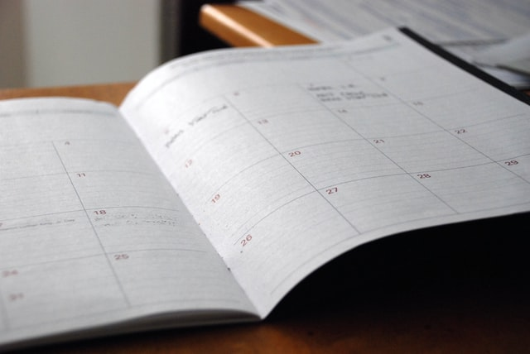
Thank you!
Next Virtual AskQC Office Hours
Time & Topic: TBD
Registration and session links available at oc.lc/askqc
Send cataloging policy questions at any time to askqc@oclc.org
Photo by Eric Rothermel on Unsplash

